Slide 1
Team 3
McBurnett, Kyle
Kim, Mi Yon
Tolleson, Chad M.
Cherukuri, Avinash Varma

Slide 2
Collaboration
52 (30%)
Sprint 2 Commits
171
Project Commits
73 (43%)
Sprint 3 Commits
46 (27%)
Sprint 1 Commits
28%
More Commits from Sprint 2

Slide 3
Collaboration
28 (46%)
Sprint 2 Pull Requests
61
Pull Requests
21 (34%)
Sprint 3 Pull Requests
12 (20%)
Sprint 1 Pull Requests
Average 3
Comments per Pull Request

Slide 4
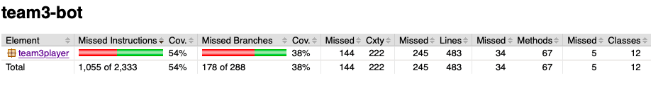
Code Coverage
54%

Slide 5
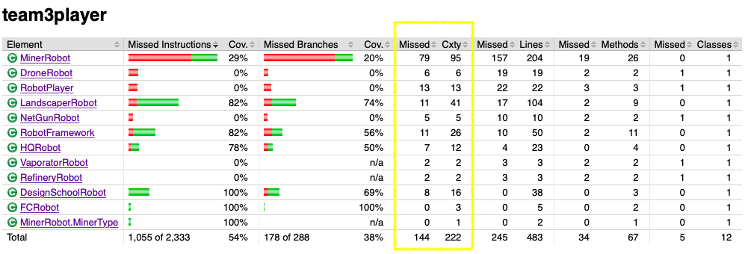
Cyclomatic Complexity

Slide 6
Sprint 3 Strategy
Priority 1
Expand Testing Coverage
Priority 2
Refractor Code
Priority 3
Improve Land-scraper and Drone
Priority 4
Update BlockChain Strategy

Slide 7
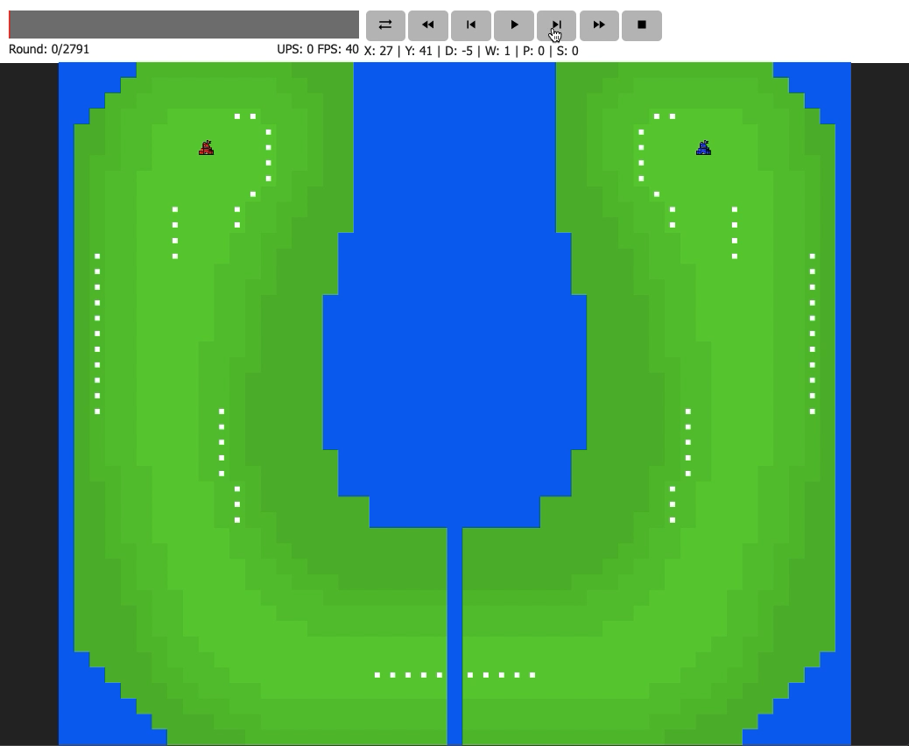

Game Play

Slide 8
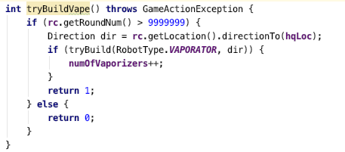
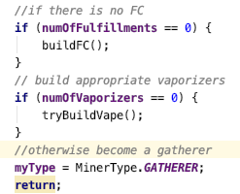
Exists in Code, not in Strategy

